Slide 1
Web Socket
Network Programming

Slide 2
What is Socket ?
A socket is one endpoint of a two way communication link between two programs running on the network. The socket mechanism provides a means of inter-process communication (IPC) by establishing named contact points between which the communication take place.
Unix Socket or Windows Socket
TCP Socket Gives the most reliable communication across the network.
TLS Socket Configurable and secure network socket over SSL. = HTTP

Slide 3
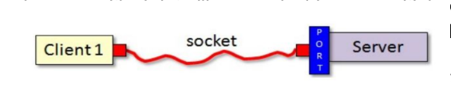
UDP Sockets
UDP Sockets Gives the fastest network communication. UDP is less reliable but much faster than TCP.
It is best used for streaming non critical data like sound, video, or multiplayer game data as it can drop packets depending on network connectivity and other factors.
UDP can be used for local IPC as well, but is slower than #1's Unix Socket or Windows Socket Implementation because UDP sockets go through the network card while Unix and Windows Sockets do not.

Slide 4
net module
Node.js net module is used to create both servers and clients. This module provides an asynchronous network wrapper.
Variants of sockets in Node:
TCP
UDP
Websocket
UNIX domain (node-ipc package)
There are two categories of TCP socket programs you can write:
Server - listens for connections to it from clients and send data to the client
Client - connects to a TCP server exchange data with it. The communication between client and server happens via sockets

Slide 5
npm Packages for web-socket
Module / Library | Type | Purpose | Protocol Used | Use Cases | Key Features
node-ipc | External npm library | Inter-process communication (IPC) between Node apps, processes, or systems | Supports TCP, UDP, Unix/Windows Sockets | Messaging between processes, microservices communication | High-level API, supports JSON, secure communication, cross-platform
net | Built-in Node.js module | Provides TCP socket programming | TCP | Building custom TCP servers/clients, chat apps, database drivers | Low-level API, full control over sockets, event-driven
dgram | Built-in Node.js module | Provides UDP socket programming | UDP | Streaming, VoIP, DNS, games, IoT device communication | Lightweight, connectionless, fast but no delivery guarantee
ws | External npm library | WebSocket implementation for Node.js | WebSockets (built on TCP) | Real-time apps (chat, gaming, live dashboards) | Lightweight, full-duplex communication, supports client/server

Slide 6
WebSockets for Developers
Independent TCP-based protocol (full-duplex communication).
Transport layer → supports sub-protocols (XMPP, STOMP, AMQP).
Moves beyond HTTP request-response model.
Requires:
Client → JavaScript WebSocket API.
Server → WebSocket gateway or protocol libraries.

Slide 7
Use cases
Multiplayer online games 🎮
Chat applications 💬
Live sports ticker 🏏⚽
Realtime social feeds & dashboards 📈
WebSockets power both web and mobile apps with real-time interaction.

Slide 8
Server and Client Side
Build WebSocket server with libraries:
Node.js → ws, socket.io
Java → Jetty
Python → Tornado, pywebsocket
PHP → Ratchet, phpws
Communicates with many client types.
Client Side
Supported in all modern browsers.
Clients: Web browsers, mobile apps, Java, Node.js, .NET, PHP.

Slide 9
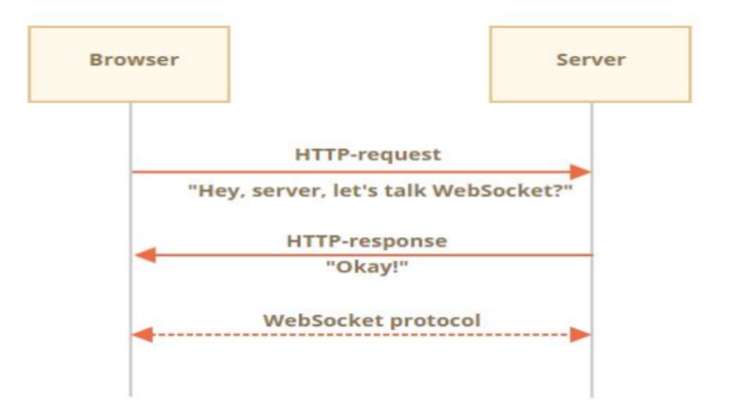
WebSocket Connection Flow
WebSocket Connection Flow
Client sends HTTP request with Upgrade: websocket.
Server upgrades connection → handshake complete.
URL scheme: ws:// or secure wss://.
After handshake:
Client ↔ Server exchange messages freely.
Low latency, minimal overhead.
Enables simultaneous communication.
Package: ws
Lightweight Node.js WebSocket library.
Faster than HTTP polling, full-duplex channel.

Slide 10
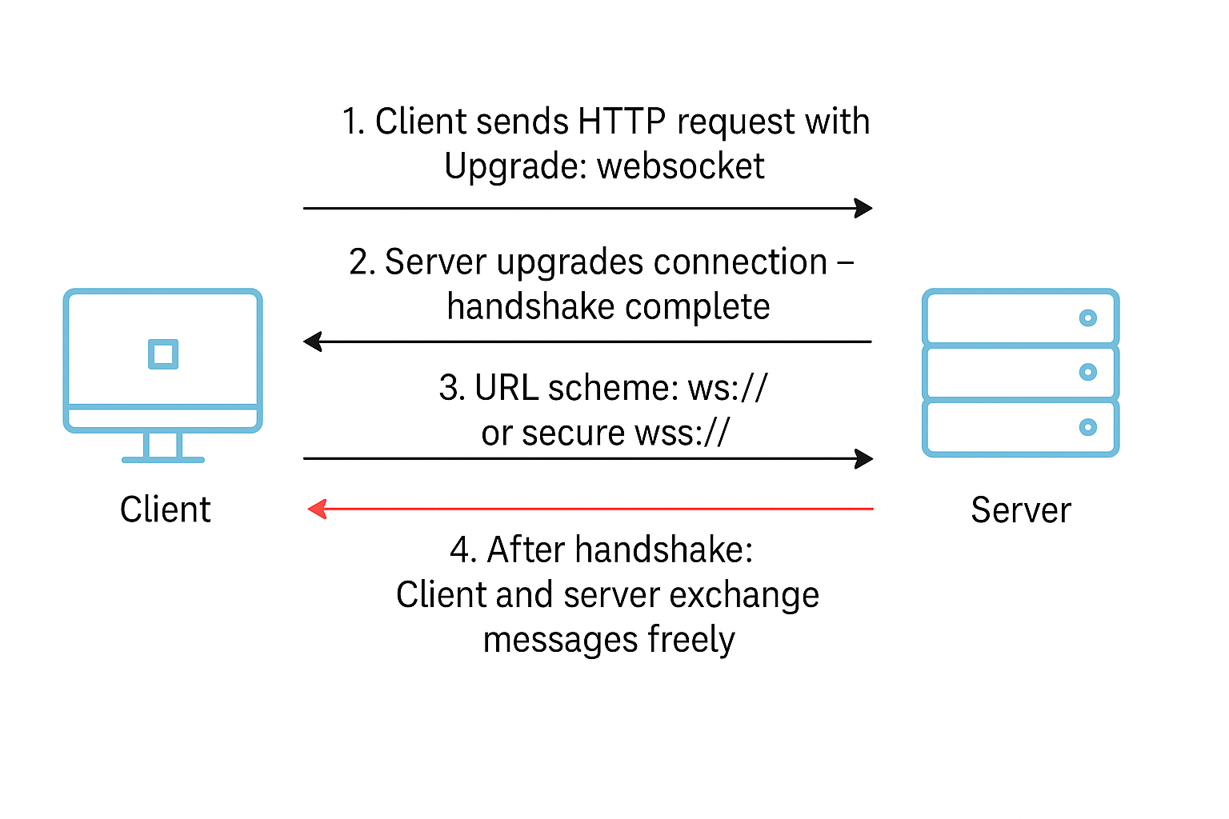
Full Flow

